Slide 1
New England Collaborative Data Management Curriculum
MODULE 7:
Repositories, Archiving, and Preservation
Emily R. Novak Gustainis, Countway Library, Harvard Medical School
Darla White, Countway Library, Harvard Medical School
David B. Lowe, University of Connecticut Libraries

Slide 2
Part A: Learner Objectives
Navigate choose, and integrate repositories into the life cycle of their research.
Distinguish among types of repositories , including their stakeholders, purposes, and requirements.
Critically evaluate repositories’ scope and policies.
Deposit data into a repository.
Utilize repositories to measure the impact, quality, and quantity of their or their institution’s scholarly output.

Slide 3
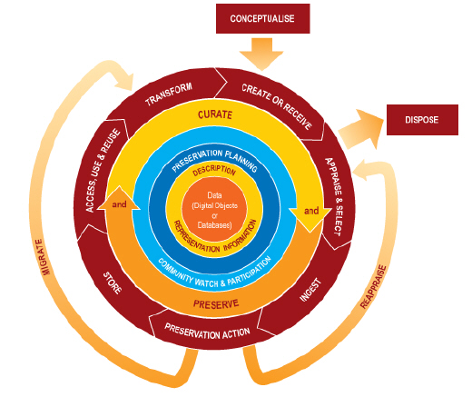
Data Life Cycle Model (Digital Curation Centre, UK)

Slide 4
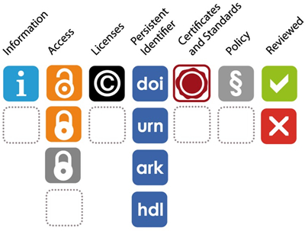
Resources to Identify Research Data Repositories
Databib: http://databib.org/
OpenDOAR: http://opendoar.org/
Registry of Research Data Repositories (re3data): http://www.re3data.org/ re3’s icon system:

Slide 5
Repository Scope & Policies
Cost
For now, many are free up to a max (e.g. Dataverse up to 1TB)
For sustainability, new cost models are likely to come
Consider direct cost line item charge to grant, if possible
Indexing or “Discovery tools” or SEO
Typically open to search engines via OAI/PMH protocol
Keep eye on SHARE initiative (jointly ARL, AAU, APLU)
Persistent identifiers for deposited files
Important thing is to have one, not so much which type
But handle, doi, & ark are the top 3 used (ARL Spec Kit 334, p. 54)
Policies & Licenses
Open vs. closed or restricted; also embargo options
Creative Commons or similar licensing required by some for deposit
Certificates & Standards
Early yet; librarians most involved with ISO 16363 (AKA “TRAC”)
Professional Metrics Reporting (see below)

Slide 6
Repository Deposit Steps
Self-deposit (mediated similar; just designate contacts):
Create login and log in
Assemble:
Data files
Readme.txt
Any related additional files
Verify:
File size max limits not exceeded (per file or as set)
Copyright is yours
No PII (personally identifiable information) in the data
Deposit agreement:
Declare you have right to deposit
Give permission to repository to perform preservation and access procedures
May require licensing (Creative Commons or similar)
Upload

Slide 7
Professional Metrics
Growing recognition that data deserves to be credited like other professional activities
Repositories can count usage (esp. downloads) and report tallies/time
Such numbers, thriving in new social media environments, have spawned “altmetrics” services
Important to know:
Whether the repository provides at least usage reports
Whether this reporting is integrated with more extensive altmetrics services and related features such as user ratings or comments, and potentially citation count compilation
These new features are increasingly appearing in PTR dossiers and grant proposals

Slide 8
Part B: Objectives of Data Retention Requirements
To make research findings available for corroboration
To promote reuse
To support Open Data initiatives
To support intellectual property rights
To inform you of the minimum period of time that you are required by your funder or institution to maintain your data

Slide 9
How Long to Keep Data?
Your Retention Policy will tell you
Policies are set by your Institution or granting agency
Researchers are responsible for understanding retention expectations so that they may plan for budget, future storage, and ongoing oversight
Policies vary from funder to funder, institution to institution

Slide 10
What Happens Next?
Once your retention period has been met:
Some data may be kept permanently (Permanent Retention/Archiving):
Determined on a case by case basis
Involves a long term investment of resources by an Archives or Special Collections
Not the same as Long Term Storage
Some data might NOT be kept (Data Disposal):
Ensures data cannot be reconstructed or extracted
Documenting disposal decisions helps to avoid future confusion about missing or abandoned data

Slide 11
How Will I Know if My Data Should be Archived?
Appraisal
Involves an inventory of records
Usually conducted with an Archivist or Records Manager
Objective is to identify the impact of the data as well as basic information about the data and the project.

Slide 12
Appraisal Questions
What are the essential records required to understand this research data and project?
What was the impact of this research on its discipline?
What had been the impact of the researcher in his or her field?
Is the research data replicable?
Is there an index to the data? How would future researchers understand the research?
Has this research been published? Where?
Has the data been kept in a research repository?
Are there additional records related to the data?
Are there security or access issues?
Does someone else own the data?
Identification of Related Records

Slide 13
Related Records
May provide context to the data or project overall
Key element in considering a collection of research data for permanent retention in an archive
Help someone unfamiliar with the details of the research make sense of the overall project’s mission, progress, and findings
May have different retention periods than the research data
Examples of Related Records include:
Human or animal subject protection records
Administrative records
Financial records

Slide 14
So When Should My Data be Archived?
The data are not available anywhere else, or are not likely to be available elsewhere in the future
The research is in line with the collecting policies of an institution
Related records are well maintained, comprehensive and available for archiving
Ownership is clear
Standards for privacy and confidentiality of subjects studied are clear
The technical documentation is comprehensive
The data are in a format that facilitates ease of use and preservation

Slide 15
Who Decides?
Many stakeholders will contribute to research data policies and archival recommendations, including:
Department within which the research was conducted
Archives or Special Collections Department
Records Management Office
Office of Information Technology and Security
Office of General Counsel
Office of Research Compliance
Office of Sponsored Programs
Office of the Dean or Provost

Slide 16
Part C: Objectives of Long Term Data Management
Consistent, citable access to data and associated contextual records
Ensuring that protected data stays protected through repository-governed access controls
Ensuring the integrity of the data itself beyond mandated retention periods
Notes:
Conceptually, long term data management and long- term preservation have these same objectives. however, long-term data management speaks to the intellectual responsibilities and actions of the researcher, while long-term preservation addresses the technical requirements necessary to ensuring access that is “permanent and persistent.” (”…permanent and persistent” per Michigan State University Libraries. http://lib.msu.edu/rdmg/servcat/longterm/. Accessed 05 February 2014.)
Good long-term data management includes the selection of a repository, whether hosted by your institution or not, to ensure baseline descriptive information about research is captured along with the dataset and that certain technical processes are performed routinely and reliably to maintain data integrity.

Slide 17
Prior to Deposit, a Researcher/P.I.:
Appraises
Collocates
Organizes
Checks policy
Consults
Converts
De-identifies
Appoints
Costs
Notes:
[Corresponds to table breaking our Researcher/Repository roles]

Slide 18
When depositing, a researcher/P.I. …
Creates descriptors (metadata) using repository tools and forms for the research data itself
Creates descriptors (metadata) for the research project, staff, institution(s), and funders that produced the data
Provides contextual information and uploads research records

Slide 19
Minimum Deposit Recommendations: Biomedical Research
Raw data, not just processed or summary data
A description of the project methodology
An explanation of how data was handled post-collection
Codebooks, or other records that link subjects or experimental processes to data
Project-generated software and computer code created to collect, analyze, or deliver data, especially computer code stated as a grant or project deliverable
Any records referred to in publications about the research
Notes:
NOTE: Swap out record types for those of different disciplines

Slide 20
Qualities of a Preservation Repository
Committed to the organizational infrastructure of the repository (stability)
Has clearly articulated policies relevant to digital object management and use of current technologies (transparency)
Has transparent technical infrastructure/architecture and addresses data security (security)
See: http://www.dcc.ac.uk/resources/repository-audit-and-assessment/repository-audit-and-assessment
Notes:
An excellent overview is available on the Digital Curation Centre’s “Repository audit and assessment pages” (http://www.dcc.ac.uk/resources/repository-audit-and-assessment/repository-audit-and-assessment) as well as the “Ingest” section of the DC 101 training materials on the curation lifecycle model (http://www.dcc.ac.uk/sites/default/files/documents/DC%20101%20Ingest.pdf).

Slide 21
Types of Repositories and Cost Planning
Repositories many be free, fee-based, or institutionally hosted
What are the differences?
The advantages?
The disadvantages?
All have different costing models
Notes:
Repositories for the long-term management and preservation of data and associated records can be free, fee-based, or institutionally hosted (with or without cost to the researcher), and either open or closed to public access. While depositing to an open access repository is a necessity for government-sponsored research (and preferable from a knowledge-sharing and community building perspective), data can be preserved in closed access (commercial) storage services as long as the host institution is provided unfettered access to accounts. The benefits of commercial repositories over open access repositories and institutional repositories may include: 1) A higher level of system support; 2) Tools that make deposits easier than open source tools; 3) Higher levels of data security, such as for HIPAA-protected research data or other human subjects data and confidential information requiring a high-level of security; and 4)Insurance against data loss. Disadvantages may include: 1) Closed to reuse by the academic enterprise; 2) Not citable or discoverable online; 3) Lack of access or download metrics; 4) Ongoing cost commitments on the part of the institution (e.g. storage fees, per-file download and upload service fees); 5) Opening accounts that may be known to only a few researchers and are at risk for abandonment; 6) Time needed for vendor review/approval by your institution’s Chief Information Security Officer (if required). Two examples of commercially available, secure online storage services are Amazon S3 storage which varies from .01-.085 per gigabyte a month and Arkivum ,which ranges $587.02 (£360) - $733.77 (£450) annually with educational discount depending on the number of terabytes needed.

