Slide 1
Slides Template for Module 6
Data Sharing & Reuse Policies

Slide 2
Learner Objectives
Explain the benefits of sharing data
Identify issues/obstacles related to reuse and sharing of data
Understand open access/open science/open data
Understand data reuse/sharing/access policies from funding agencies, institutions and publishers
Recognize the need to use standard data formats, consistent file naming conventions, etc.
Contrast sharing data within and outside of a research team
Understand the need for data attribution and citation

Slide 3
History of Sharing Data
What’s Old
Sharing one on one
Sharing as part of a small lab team
Sharing between faculty and students
Sharing a few compiled results (tables, diagrams) within the context of a publication
What’s New
Sharing with large numbers of researchers outside one’s research team
Sharing data as a distinct entity not as a supplement to paper
Broad dissemination via the internet
Sharing with the public
Notes:
Data sharing goes back centuries. Amongst scientists and their assistants in small research teams, data sharing has always been the norm. Going back four centuries, Johannes Kepler, assistant to Danish astronomer Tycho Brahe, discovered the laws of planetary motion after poring over Brahe’s carefully catalogued observations.
Traditionally faculty and students working together on a project share data. Authors of scientific publications historically have “shared” their data by integrating a few tables or diagrams within the context of a paper. What is new is the idea of disseminating data widely via the internet. Enabling the global dissemination of data, the internet enables multiple players outside of the data creators’ network to view data and reuse it. The idea of sharing data strictly as a valuable research output in its own right—not as a supplement to a paper—and sharing data with the public at large is only a few decades old.

Slide 4
Why Share Data?
Data as a public investment
Required by publishers
Required by government funding agencies
Informs new research
Maximizes transparency, accountability and scrutiny of research findings
Notes:
Contributes to society’s greater good; data as a public investment
Required by publishers
Required by government funding agencies
Allows data to be used to answer new questions and inform new research
Maximizes transparency, accountability and scrutiny of research findings
Remember to expand upon the importance & benefits of sharing data, but ultimately it is because of funding agency requirements.
See OSTP Open Data Policy http://www.whitehouse.gov/sites/default/files/omb/memoranda/2013/m-13-13.pdf
References: University of Virginia Data Management Consulting Group, Archiving and Sharing Data, http://dmconsult.library.virginia.edu/plan/sharing/
UK Data Archive, Create and Manage Data: Planning for Sharing: Why Share Data? http://data-archive.ac.uk/create-manage/planning-for-sharing/why-share-data

Slide 5
Why Share Data?
Increases the impact and visibility of research
Provides credit to the researcher as a research output in its own right
Critical to the success of collaborative research
Reduces duplication of effort
Provides great resources for education and training

Slide 6
Who Benefits?
  Researcher and research team
  Scientific communities (including citizen science)
  Students
  Public
  Funding agencies

Slide 7
Reuse and Sharing Issues
  Faculty/Researchers Reluctant to Share Data
  Don’t understand the need or benefits to sharing data
  Poor quality data sets due to experimental design, mismanagement
  Don’t want to lose control of data
  Fear criticism
  Legal ramifications
Notes:
Several reasons for not sharing data: proprietary concerns, monetize/patent discoveries, lack of attribution, data irrelevant to others, data misused, not feasible to make data ready for other users, would like to extract more value out of data before making data available, or data isn’t retrievable

Slide 8
Reuse and Sharing Issues
Students’ lack of awareness of value of data
  Don’t understand that others might want their data or data could be useful in future project
  Lack of data management training
  Uneasy about sharing potentially confidential data
  In group projects lack of clarity over who is responsible for data
Notes:
Research Groups: PI/Co-PI may not train student in data management; many student researchers have rotated through the lab; often data management practices taught ad hoc or not at all.

Slide 9
Potential Legal & Ethical Restrictions on Reuse
Licensing
Copyright: Representation of data (graphs, tables, models, etc.)
Institutional Data Policies
IRB (Institutional Review Board)
Funding Agency Policies (public/private)
Notes:
Institutional Policies: legal & ethical policies
Anonymization/Confidentiality/Informed Consent

Slide 10
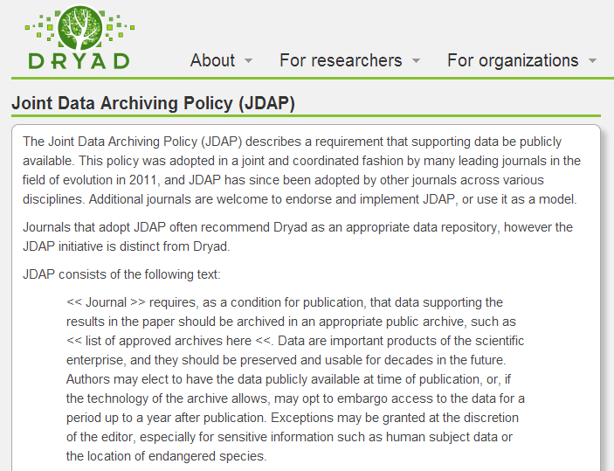
Publisher Restrictions
Notes:
JDAP is an agreement among publishers to make the datasets that underlie published articles available for public access. http://datadryad.org/pages/jdap

Slide 11
Data Sharing Policies
National Science Foundation
“[NSF] expects PIs to share with other researchers, at no more than incremental cost and within a reasonable time, the data, samples, physical collections and other supporting materials created or gathered in the course of the work.”
Notes:
National Science Foundation (NSF)
Requirements:
Data management plan, http://www.nsf.gov/pubs/policydocs/pappguide/nsf11001/gpg_2.jsp#dmp

Slide 12
Data Sharing Policies
National Institutes of Health
The data produced in the course of the funded research “should be made as widely and freely available as possible while safeguarding the privacy of participants, and protecting confidential and proprietary data.”
Notes:
National Institutes of Health (NIH)
Requirements:
Data sharing plan for grants over $500,000, http://grants.nih.gov/grants/policy/data_sharing/
Published research papers must be open access according to the NIH Public Access Mandate.

Slide 13
Open Science
Transparency in experimental methodology, observation, and collection of data.
Public availability and reusability of scientific data.
Public accessibility and transparency of scientific communication.
Using web-based tools to facilitate scientific collaboration.
Notes:
Open Science is an umbrella terms for science that encompasses these four goals. Open science is carried out and communicated in ways that allows others to contribute, collaborate and add to the research effort, with all kinds of data, results and protocols made freely available at different stages of the research process.
Proponents of Open Science argue that promoting collaboration in science will lead to more efﬁcient research and innovation.
The first goal, Transparency in experimental methodology, observation, and collection of data is critical . Without access to experimental methodologies—and this includes the software codes that are needed to process data—experiments cannot be verified or replicated. For research to be reproducible, all software code and raw data used to obtain experimental results need to be documented and archived.
Web-based tools that facilitate scientific communication can include a range of online tools such as online notebooks to google docs to YouTube videos to a video sharing site Benchfly—they are all tools that facilitate scientific collaboration

Slide 14
Open Data
“A piece of data or content is open if anyone is free to use, reuse, and redistribute it– subject only to the requirement to attribute and/or share-alike” (Open Knowledge Foundation).

Slide 15
Panton Principles
1. When publishing your data, make an explicit and robust statement of your wishes.
2. Use a recognized waiver or license that is appropriate for data.
3. Non-commercial and other restrictive clauses should not be used.
4. Explicit dedication of data underlying science into the public domain (CCZero) (Panton Principles 2010; SPARC)
Notes:
‘Science is based on building on, reusing and openly criticizing the published body of scientific knowledge.
For science to effectively function, and for society to reap the full benefits from scientific endeavors, it is crucial that science data be made open” (Panton Principles 2010).

Slide 16
Sharing Data Within a Research Group
Location of data
Folder structuring
File naming standards
Versioning
Formats
Responsibility
Communication
Documentation and Back up
Notes:
You may want to share data among other team members that are working on different aspects of a project. These are some considerations to aid you in being organized and making sharing data easier.
Location: where is it stored?
Folder structure: how easily can you locate folders?
File naming standards: are files logically labeled?
Versioning: how do you know if this dataset represents the latest data?
Formats: can this file be easily opened?
Responsibility: whose job is it to oversee this organizational structure? Who is documenting and performing quality assurance?
Communication: does everyone know where information is stored and how to access it?
Documentation and Back up: how do you record information and share information in the laboratory notebook? Are paper notebooks scanned? Where are these stored and how are they shared?

Slide 17
Sharing Outside the Research Group
Consult your university data policy/intellectual property policy
Consult funders’ policies
Consult your PI
Consult your IRB office
Notes:
Be aware of patient confidentiality– does the data set need to be anonymized?
Beware data ownership– do you have the right to share these data?
Timing: At which point do you share data? What is your purpose of sharing data? Do you share raw data/analyzed data? Should data be “peer reviewed”? How do you version this data? Which dataset will you submit to a repository? What type/how much to share for different steps: publication, archival and preservation, retention requirements by funders, institution, IRB,

Slide 18
Why is it Important to Cite Data?
Provides appropriate credit (avoids plagiarism)
Helps data producers know how their data is being utilized
Enables other researchers to access data for their own use or to replicate research findings
Assists in measuring the impact of a data set by tracking references to it in the scientific literature or in online conversations (“altmetrics”)
Notes:
Please explain the consequences for not citing data. Using and not citing data is plagiarism (unethical and unprofessional). Citing data is important to receive credit for and measuring the impact of your scholarly output, including your datasets. (Discuss Altmetrics’ incentives).

Slide 19
How to Cite Data?
Author/Creator(s): the creators of the data
Title: the title of the dataset
Version: the exact version or edition of the data set
Publication Date: the date when the data set was published or released
Publisher/Archive: the data center or repository that is archiving and distributing the data
Identifier/Locator: URL or other locator for the data (e.g. a persistent URL such as a DOI or a handle)
Notes:
Data citation is evolving and there is currently no acknowledged standard on how to cite a dataset or construct a data citation. Generally a data citation includes all the same components as any other citation.
DOI = Digital Object Identifier (http://en.wikipedia.org/wiki/Digital_object_identifier)
Authors should cite data they use according to established journal or professional guidelines. Style manuals such as APA and NLM Citing Medicine provide some guidance.
The Digital Curation Centre (DCC) in the UK has released comprehensive data citation guidelines that can be applied to almost any discipline, available at http://www.dcc.ac.uk/resources/how-guides.
Repositories often provide guidance on how to cite their data sets.

Slide 20
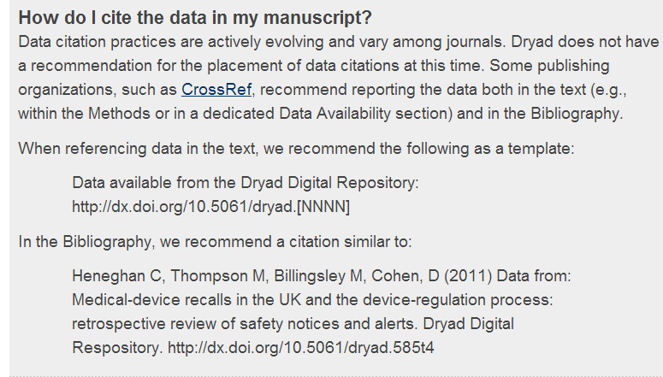
Citing Repository Data
Notes:
Credit: Dryad

