Slide 1
Slides Template for Module 5
Legal and Ethical Considerations
for Research Data

Slide 2
Learning Objectives
1. Explain ownership considerations related to data sharing
2. Explain and evaluate potential legal issues connected to your data
3. Explain ethical and legal considerations related to data sharing and retention
5. Recognize the importance of privacy with some forms of research data
6. Understand the importance of removing key personal identifiers to facilitate confidentiality

Slide 3
Who Owns Data?
It depends…
Who is funding your research?
What is your institution’s data ownership policy?
Are you working under a grant or contract?
Are you the PI or student working under a PI in a lab?
Notes:
Data ownership is complex and depends on your unique situation. Different funders and institutions have varying policies. Please check with your institution for more information. It pays to look into this early on.

Slide 4
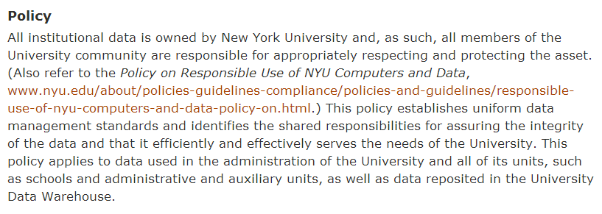
Example Institutional Data Policy
Notes:
Credit: NYU

Slide 5
Legal Concerns Related to Data
Intellectual property rights
Copyright
Patents
Trade secrets
Licensing
    Creative Commons
Monetary charges for data usage
Open source versus proprietary software
Data retention
Notes:
These will be explained further along in the lecture.

Slide 6

Licensing Data
Derived data or compiled databases can be licensed
Creative Commons licenses provide data creators options in which they can choose provisions for their data while enabling dissemination and reuse
CC0 (Creative Commons Zero) license is often recommended for scientific data
If you want to use someone else’s data—you need to know if it’s licensed, and what the terms of the license are
Notes:
While data is often not copyrightable, derived data or compiled databases are
and can be licensed
Creative Commons licenses provide data creators options in which they can choose provisions for their data while enabling dissemination and reuse
CC0 (Creative Commons Zero) license is often recommended for scientific data
Is my data copyrightable? : http://wiki.creativecommons.org/Before_Licensing
If you want to use someone else’s data—you need to know if it’s licensed, and what the terms of the license are

Slide 7
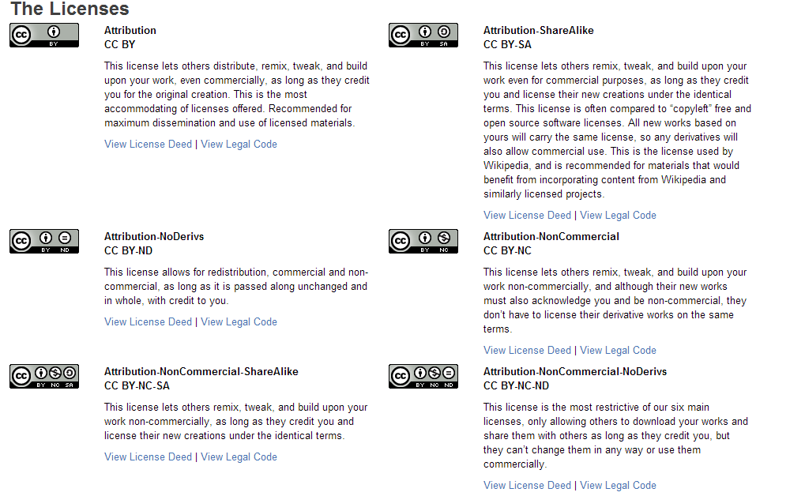
Creative Commons Licensing
Notes:
Credit: Creative Commons

Slide 8
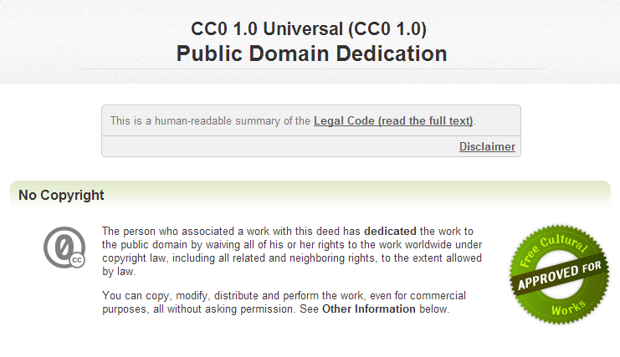
Creative Commons Public Domain

Slide 9
Legal Considerations
Check with your institution’s intellectual property office regarding the ownership of research data.
Many policies impact retention of data and related documentation for audits and investigations (IRB, institution, funder, state and federal laws).
“Copyright does not protect facts, ideas, systems, or methods of operation, although it may protect the way these things are expressed” (U.S. Copyright Office, 2012).
Notes:
This should not be construed as legal advice. Please seek legal counsel for specific legal advice on intellectual property; What do we mean when we say “data are ineligible for copyright?” Copyright does not protect facts, data, or ideas though it does protect databases”; however, trademark, patent, licensing may be applicable. NB in some countries data are copyrightable and be sure to check the relevant laws and jurisdiction.

Slide 10
Ethical Considerations for Sharing
Has your IRB approved this (or given you a waiver)?
Has the appropriate consent from subject been obtained?
Has the data set had all personal identifiers removed?
Are you using someone else’s data?
    Have you obtained appropriate permissions?
    Are you responsibly using and citing others’ data?
Notes:
Not only must consent be obtained from participants for data collection but also they must give explicit consent for the sharing of any of their data. HIPAA requires the removal of 18 personal identifiers.

Slide 11
Works Cited
New York University, Data Management Policy http://www.nyu.edu/its/policies/datamgmt.html
Dryad, How do I Cite the Data in my Manuscript? http://www.datadryad.org/pages/faq#using
Creative Commons, Licenses http://creativecommons.org/licenses/
Investigator Requirements for Retaining Research Data
http://irb.ufl.edu/irb01/data.html

