Slide 1
Teaching Research Data Management with the New England Collaborative Data Management Curriculum SLA CE Course June 13, 2015
Elaine Martin, MLS, DA
Director of Library Services, Lamar Soutter Library
Director of the National Network of Libraries of Medicine, New England Region

Slide 2
Introductions
Who you are
What you hope to walk away with from the class
Your prior experiences teaching RDM (if any)

Slide 3
Agenda
Twitter: #teachingNECDMC
Course site: https://sites.google.com/site/ummsslace
Morning
Background on NECDMC
Navigating NECDMC
Interviewing researchers, writing research cases
Teaching with research cases
Afternoon
Activity: writing a data management plan
Reporting/discussion
Exercise: Customizing the curriculum
Reporting/discussion
Panel discussion
Wrap-up/evaluations

Slide 4
Objectives
Participants will be able to:
Teach data management using the NECDMC
Use a research case to teach the NECDMC module concepts
Navigate and use NECDMC website
Customize curriculum to meet your institution’s needs

Slide 5
Use of NECDMC
This work is licensed under a Creative Commons Attribution-NonCommercial-ShareAlike 3.0 United States License.
You are free to re-use part or all of this work elsewhere, with or without modification. In order to comply with the attribution requirements of the Creative Commons license (CC-BY), we request that you cite:
Editor: Lamar Soutter Library, University of Massachusetts Medical School
the title of the work: New England Collaborative Data Management Curriculum
the URL where the original work can be found: http://library.umassmed.edu/necdmc

Slide 6
NECDMC Development History
Phase 1: Planning
Phase 2: Content development and local setting piloting
Phase 3: Expanded implementation
Phase 4: Evaluation
Phase 5: Building community: refinement and collaborative revision, additions, deletions, etc….

Slide 7
Phase 1: Planning
August 2010-December 2011
“Planning a Data Management Curriculum…”
IMLS grant w/ WPI
Project deliverable: “Frameworks for a Data Management Curriculum”
http://library.umassmed.edu/data_management_frameworks.pdf
Notes:
What are the Frameworks?
Building blocks for the course
Modular (generic)
Case-based (provides subject specificity)
NSF simplified data management plan
Readings and suggested activities
Assessments
Lesson plans for teaching RDM

Slide 8
Phase I: Planning
Interviews with students and faculty
Surveys
Outside Speakers
Educational Committee
Planning Board
Consultants
Literature search of existing open online research data management courses

Slide 9
Faculty Interviews
RDM Practices are varied
No formal RDM training provided for students
Lab managers and students come and go
Students need a familiar context to learn RDM so that can apply lessons in their own practice
This led to the idea of developing teaching cases

Slide 10
Notes:
Point here is that the modules are generic and not discipline-specific

Slide 11
Role of Having Teaching Cases
Ortho Case (2011)
Vitamin D Bipolar Depression Case (2013)
Notes:
Cases show subject-specificity.

Slide 12
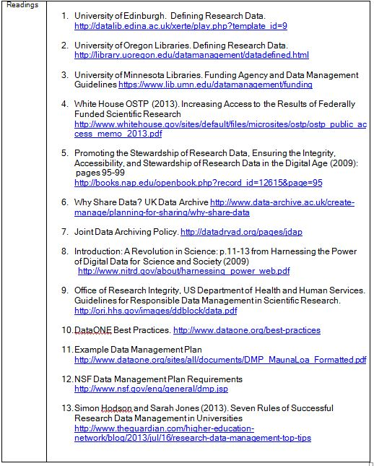
Lesson Plans
Learner Objectives
Module Content
Activities
Assessment
Readings
Notes:
Refer them to Frameworks

Slide 13
Phase 2: Content Development
May 2012-November 2013
Expanded collaboration of content contributors (Tufts, UMass Amherst, Northeastern, MBL/WHOI, Harvard)
Funding from NN/LM,NER
Content developers teamed up to create lecture notes, slides, and additional cases

Slide 14
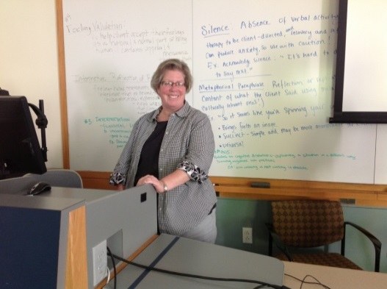
Local Piloting
Local Piloting
NN/LM, MAR Class (Philadelphia, April 2013)
90 minute class for UMMS CTSA
Scientific Data Management Course x 3 at Simmons GSLIS
“Train the Trainer Class” (2013, 2014)

Slide 15
Phase 3: Expanded Implementation Pilot Sites

Slide 16
Teaching with NECDMC: different approaches
Credit course for grad students
7 weekly workshops for staff, faculty & students
One hour overview class
Professional development workshop for librarians
Session at Scientific Conference
Full day class for graduate students
Semester LIS course
Graduate student induction course

Slide 17
Phase 4: Evaluation
Developed evaluations for each module
Pilot site instructors had students complete evaluations; these were sent to NECMDC project staff
Focused interviews
Group interviews

Slide 18
Evaluation Responses: Students
Like video “Data Sharing Snafu” in Module 1
Group activities (e.g. file formatting)
Discussions on where to keep data
Case study format helpful when paired with dmp components
Local information very important and should be prominent on slides and materials
Many would like pre-workshop handouts
Students prefer cases in their own discipline

Slide 19
Evaluation Responses: Instructors
Depth of content—mixed bag
rich depth and breadth of materials
“not shelf ready”— it takes time to sort through and select content relevant to audience
Like case study approach
Find instruction more successful with balance of lecture and activities
Helpful to have guest speakers co-present(e.g. IT)
Like customizability of materials
Don’t attempt to teach it all in 1 day!

Slide 20
Phase 5: Community
Community Bulletin Board
Join the Collaboration
Official and Unofficial Pilot partners—we want to hear from you!
Contributions to NECDMC’s collection of research cases are welcome
Morphing NECDMC to MOOC format
Customization is key! Adapting NECDMC to local needs

Slide 21
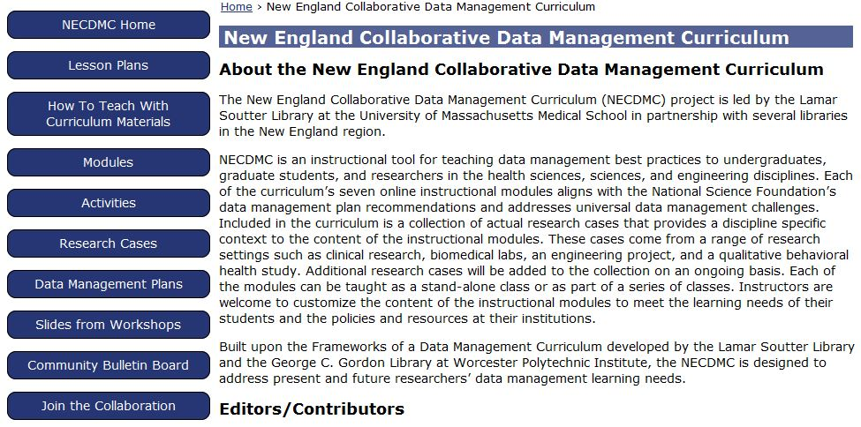
NECDMC Tour http://library.umassmed.edu/necdmc

Slide 22
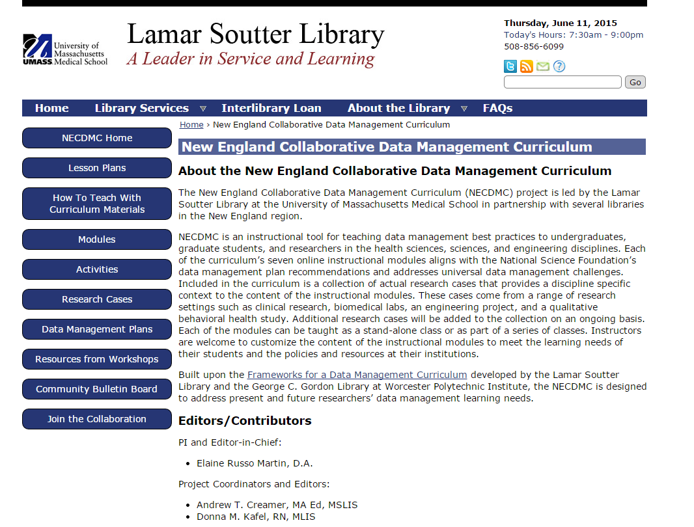

Slide 23
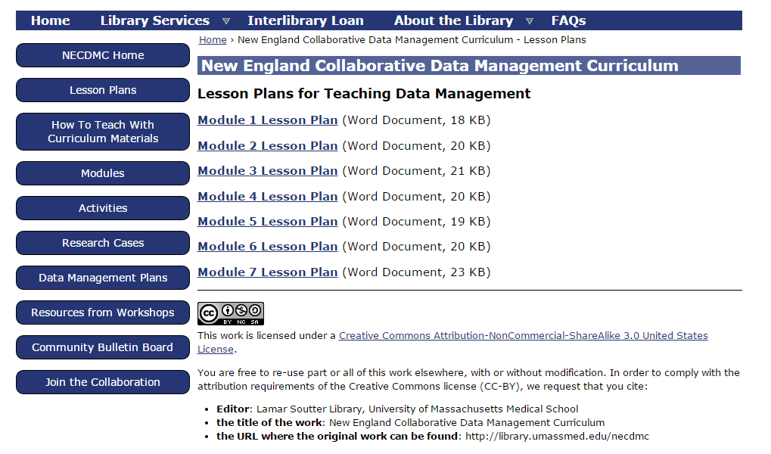

Slide 24
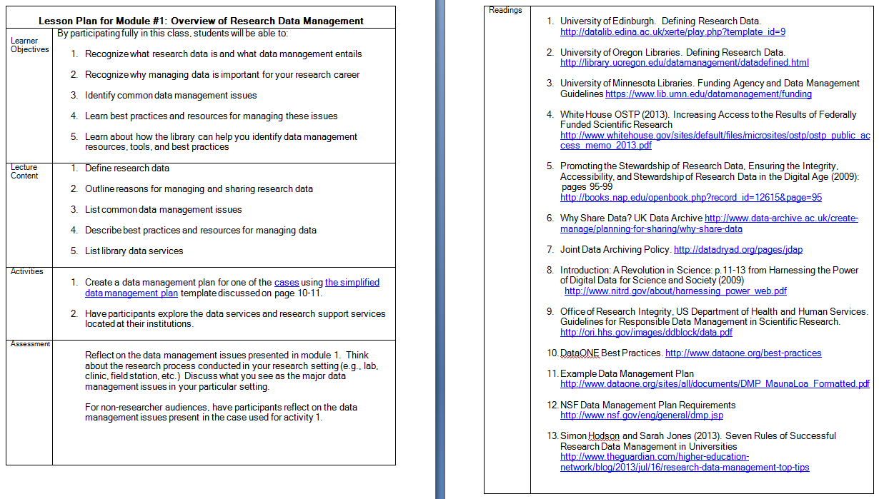

Slide 25
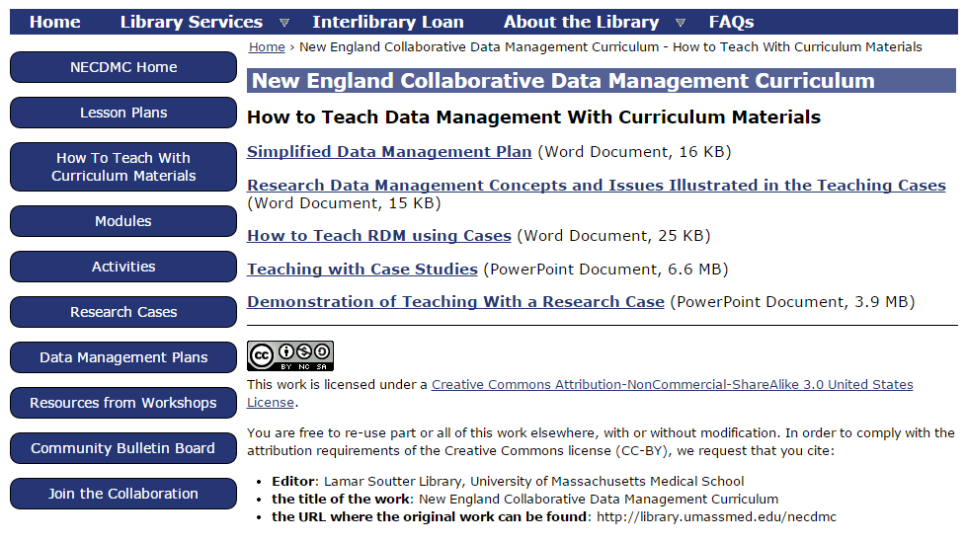

Slide 26
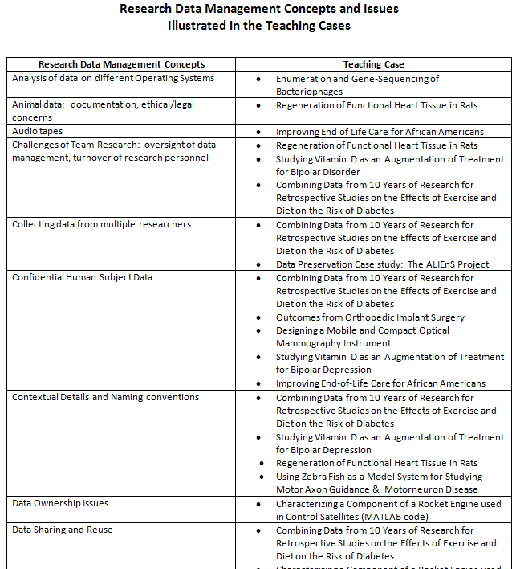

Slide 27
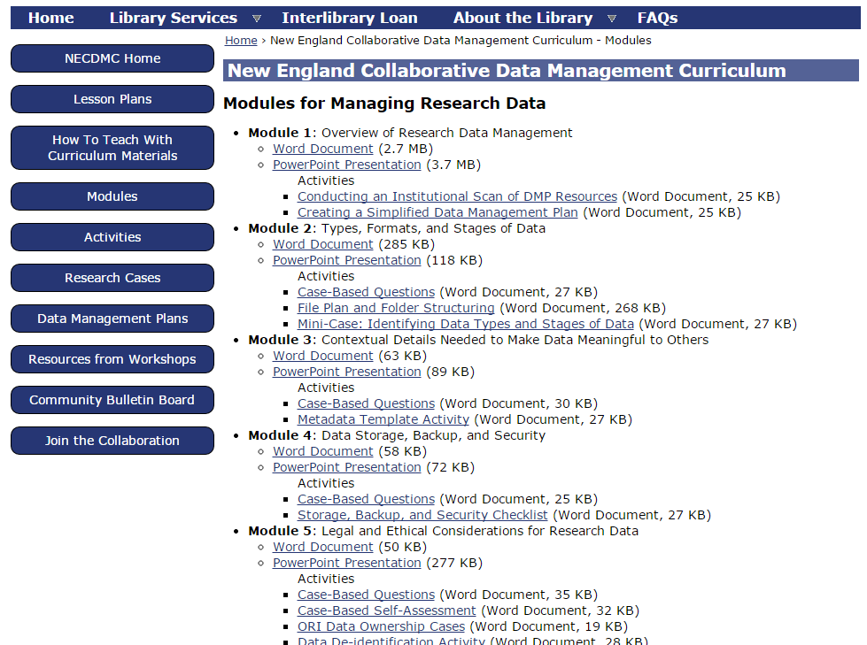

Slide 28
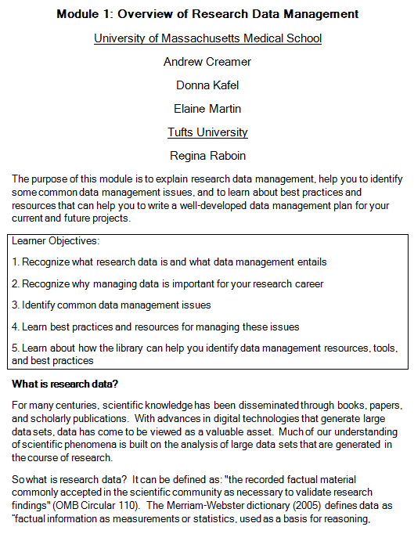

Slide 29
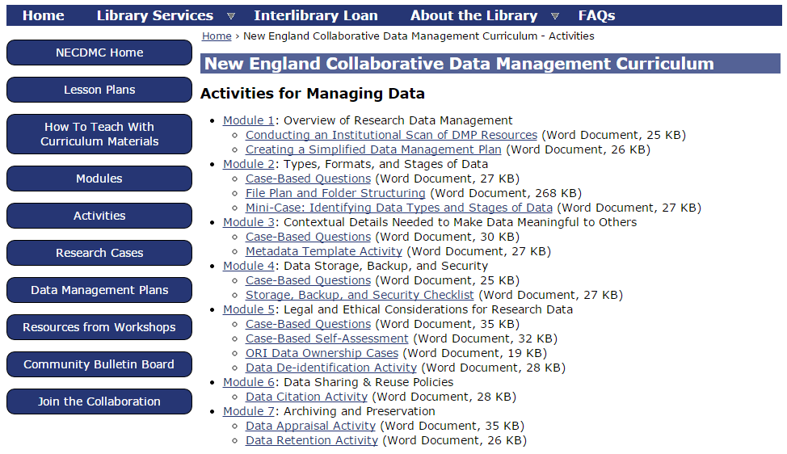

Slide 30
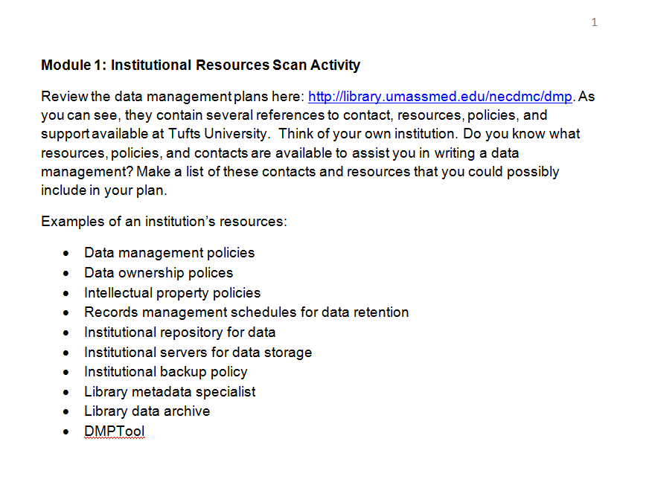

Slide 31
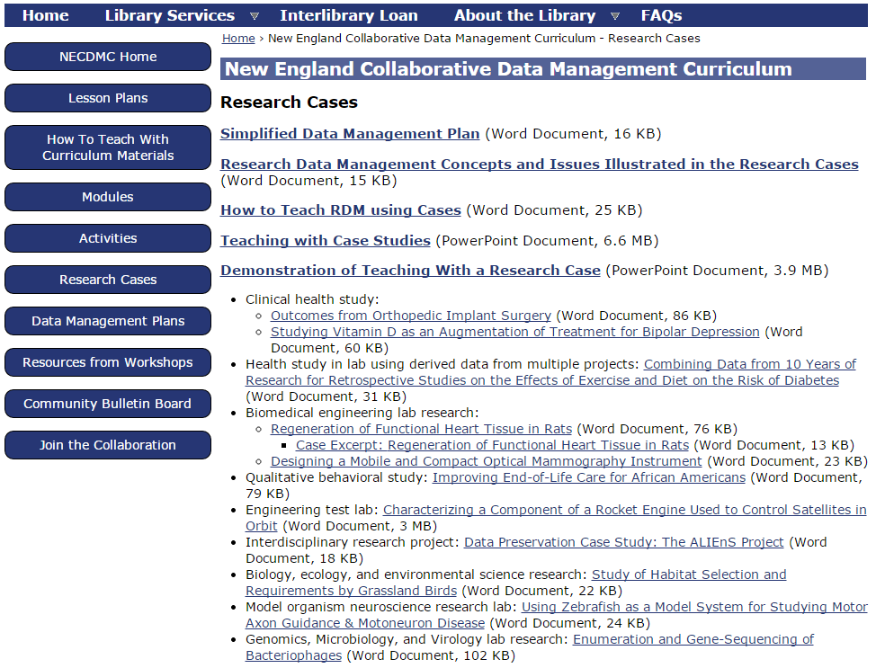

Slide 32
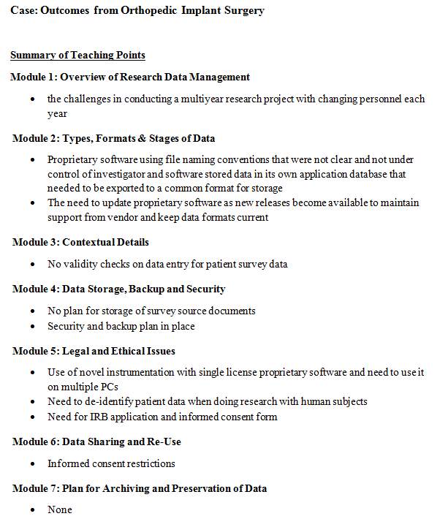

Slide 33
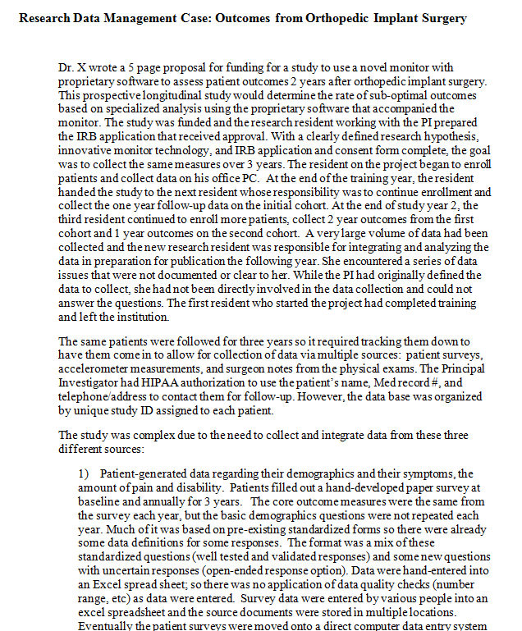

Slide 34
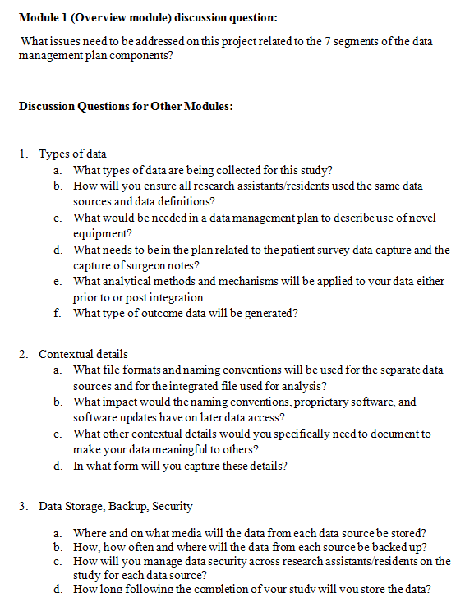

Slide 35
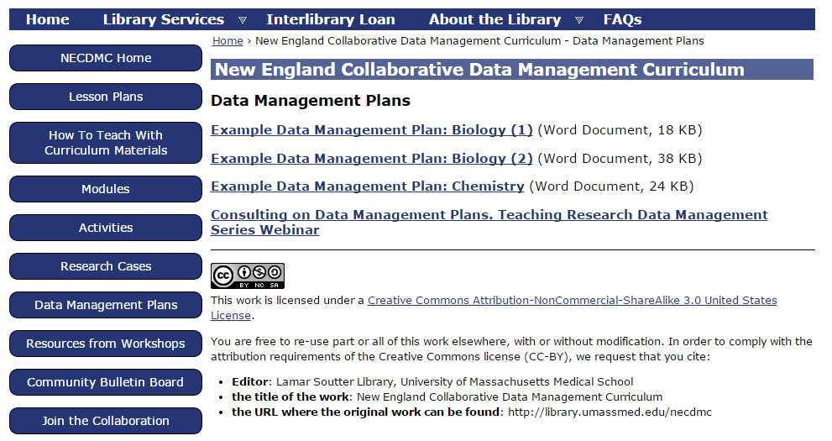

Slide 36
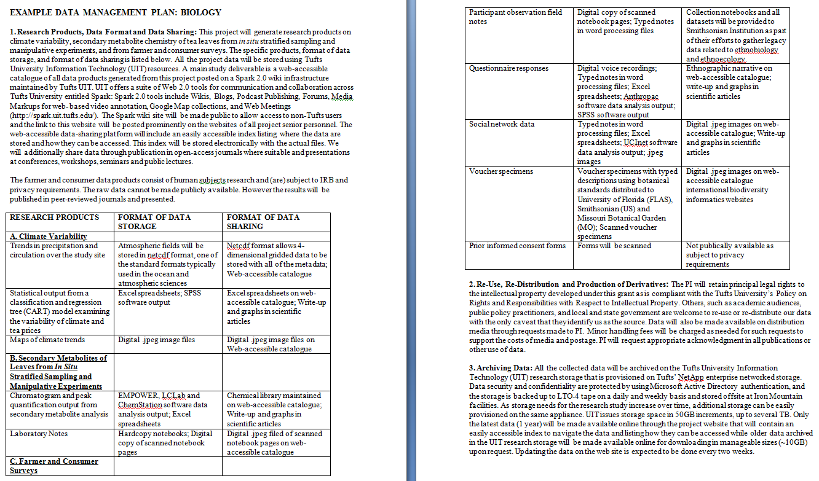

Slide 38
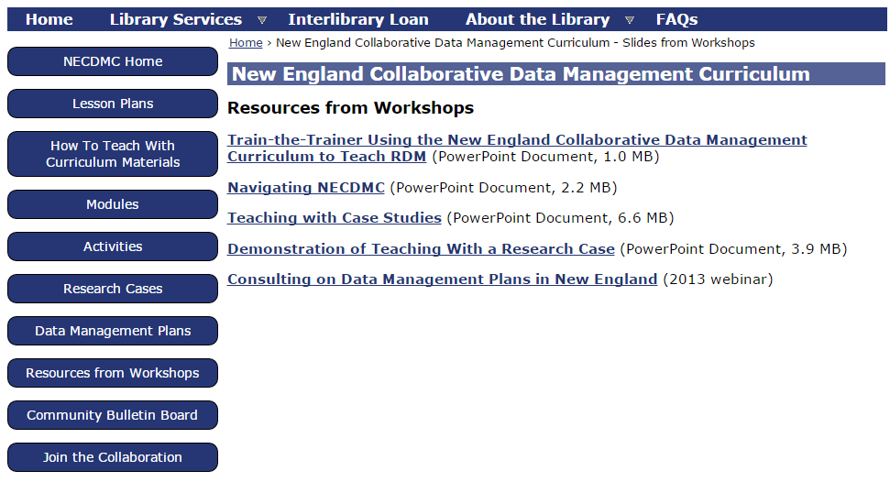

Slide 40
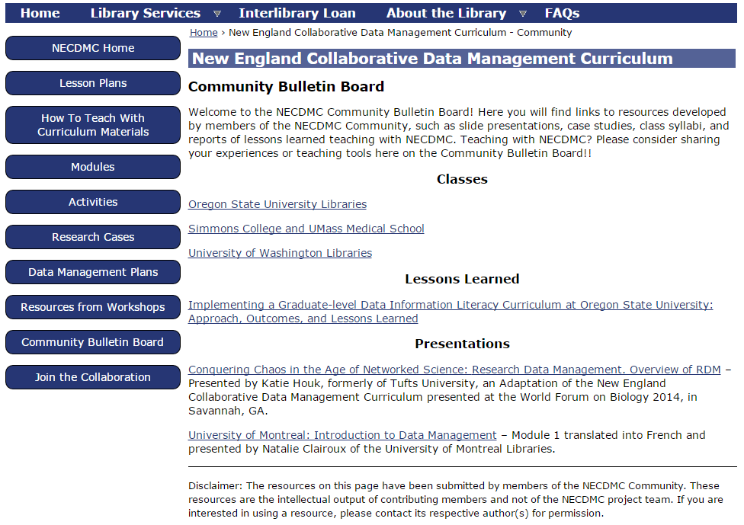

Slide 43
NECDMC Tour http://library.umassmed.edu/necdmc

