Slide 1
Navigating NECDMC
Andrew Creamer, MAEd, MSLIS
Scientific Data Management Specialist Brown University
Co-Coordinator, NECDMC
UMass Medical School
NN/LM NER

Slide 2
Organization
Mapped to NSF DMP recommendations
Case-based
A la carte
Starting place

Slide 3
Template
Local resources, tools
Local contacts
Local policies
Landscape

Slide 4
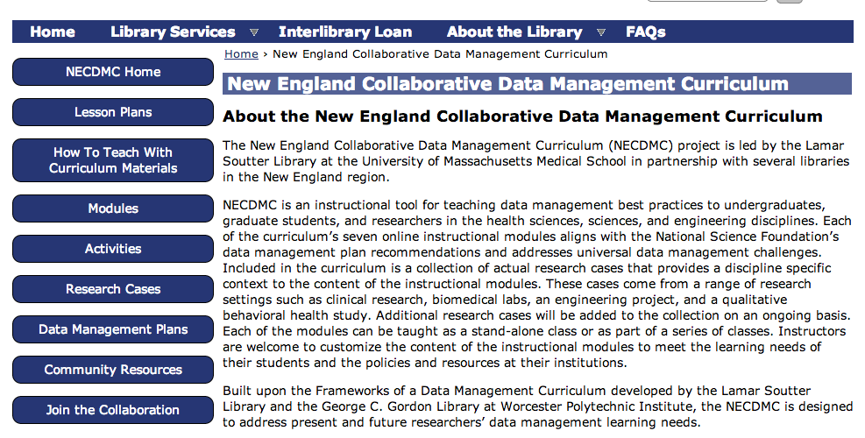
Teaching Materials
Module text
Module slides
Activities
Cases

Slide 5
Module 1
Intro to RDM
ORI data management issues
Best practices
Overview module
Showcase for local resource, tool, contacts, policies
Notes:
Evolving data management and sharing
Reasons for managing data

Slide 6
Issues
Data retention
Data ownership
Data privacy
Data storage, backup and security
Data description
Data sharing
Data archiving and preservation

Slide 7
Suggested Activities
Completing a data management plan
Looking over a real example of a data management plan
Environmental scans: To whom do I talk to about…Where do I find…

Slide 9
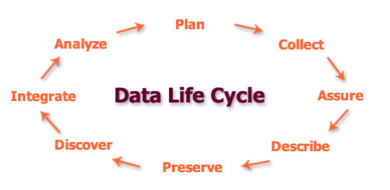
Module 2
Stages of research
Lifecycle planning
File naming
Folder structuring
Open formats

Slide 10
Activities
Identifying stages of research
File naming and folder structuring
Creating a data dictionary
Cleaning data

Slide 12
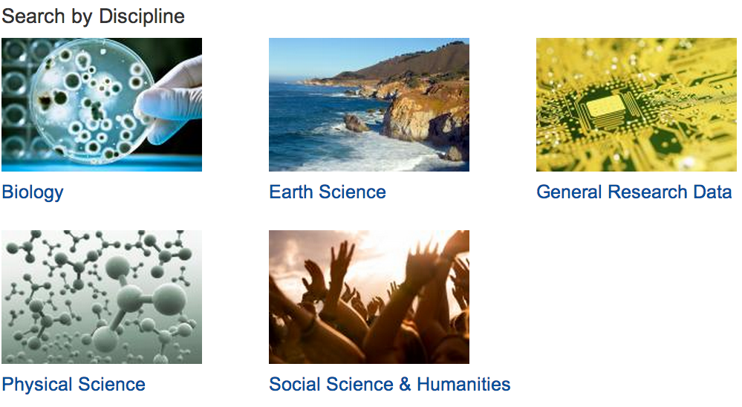
Module 3
Intro to metadata
Disciplinary metadata
Metadata for datasets

Slide 13
Activity
Interpreting metadata elements
Completing minimum metadata for a repository record
Applying disciplinary metadata

Slide 16
Module 4
Differentiating methods of storage
Explanation of backups
Options for security
Issues with the Cloud

Slide 17
Activity
Checklist
Matching options for specific situations (encumbered data; restricted access data)

Slide 19
Module 5
Data as intellectual property
Data privacy issues
Data ownership
Data retention

Slide 20
Activity
De-identifying/anonymizing data
Case studies (ownership and ethics)

Slide 22
Module 6
Sharing data
Using and repurposing data
Citing data
Measuring impact of data
Data licensing

Slide 23
Activity
Creating a data citation
Interpreting a data citation
Choosing a data license
Interpreting a data license
Interpreting a Data Use Agreement (DUA)

Slide 25
Module 7
Differentiating IR, DR, OR
Depositing data
Records management, retention and appraisal
Long-term data management
Long-term vs permanent archiving and preservation

Slide 26
Activity
Appraisal activities
Differentiating among repositories (re3data.org)
Locating data in a repository

Slide 28
Cases = Teachable Moments
Best practices
Horror stories
Disciplinary specialization

Slide 29
Customizing NECDMC
Resources, tools
Contacts
Policies
Getting the foot in the door

Slide 30
Resources and Tools
Stages of data: LabView™
Repository: BDR
Storage: RData
Ethics: Identity Finder™

Slide 31
Contacts
Who can help me store data?
Who can tell me how long to retain my data?
Who can help me to license my data?
Who can help me to describe my data?
Who can appraise my data?
Who can help me publish my data?

Slide 32
Policies
Retention Policies
Data Privacy
Data Ownership
Electronic Theses and Dissertations and Embargoes
Intellectual Property
Data Security

Slide 33
Foot in the Door
Grant writing
TA and new faculty
BEARCORE (NSF Ethics)
Broader Impacts (NSF)
T32 (NIH) and IGERT (NSF) Training grants
Research methods
Responsible Conduct of Research (RCR) Training
Undergraduate Teaching Research Awards
Notes:
Opportunities to teach NECDMC

Slide 34
For More Information
Andrew_Creamer@Brown.EDU

